Slide 1
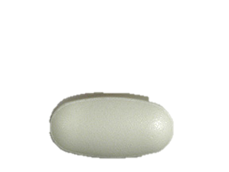
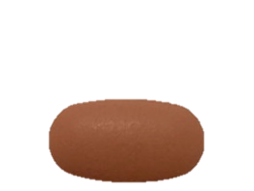
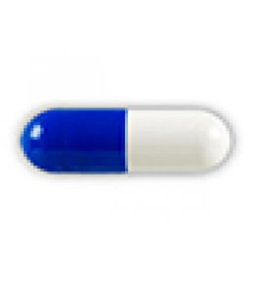
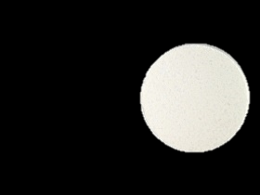

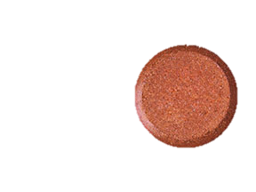
What is a Binder and Why Do I Need One?
For some people on dialysis, controlling phosphorus levels with diet alone is not enough. Therefore a medication called a phosphorus binder is ordered.
What is a binder?
A phosphorus binder is a pill prescribed by the doctor to control the amount of phosphorus in the blood.
How binders work:
Some binders work like magnets and others work like sponges. They soak up or bind to phosphorus in food during digestion. This reduces the amount of phosphorus that enters the blood. If a binder is not taken, phosphorus can accumulate in the blood
Binders are important because dialysis treatments do not remove all the phosphorus from the blood.
Common binders include:
Your doctor will determine which pill is best for you.
Auryxia® Calcium Calcium Lanthanum Sevelamer Velphoro®
Acetate Carbonate Carbonate
When do I take the binders?
They are usually ordered to be taken at the beginning of each meal. They may also be recommended with snacks or supplements.
What if I forget?
Timing with food is important. Binders work best when taken with food—the longer you wait, the less they work.
This educational material is for informational purposes only and is not a substitute for medical advice or treatment. Consult your physician regarding your specific diagnosis, treatment, diet and health questions. If you are experiencing urgent medical conditions, call 9-1-1. Brand names may have been included in this material for educational purposes only. DaVita does not endorse one brand over another. There are other brands in addition to these that can be equivalent.
©2015- 2019 DaVita Inc. Proprietary and confidential. For internal use only.

Slide 2
Reference:
Davita.com/diet-nutrition/articles/basics/phosphorus-binders-or phosphate-binders-and-the-dialysis-diet
This educational material is for informational purposes only and is not a substitute for medical advice or treatment. Consult your physician regarding your specific diagnosis, treatment, diet and health questions. If you are experiencing urgent medical conditions, call 9-1-1. Brand names may have been included in this material for educational purposes only. DaVita does not endorse one brand over another. There are other brands in addition to these that can be equivalent.
©2015- 2019 DaVita Inc. Proprietary and confidential. For internal use only.

